Slide 1
English
Unit 2 – Sport
WALT:
Make a piece of writing using the first conditional and modal verbs.

Slide 2



WALT: Make a piece of writing using the first conditional and modal verbs.
I can create a poster about a sport.
I can include modal sentences in my poster.
I can include the first conditional in my poster.

Slide 3
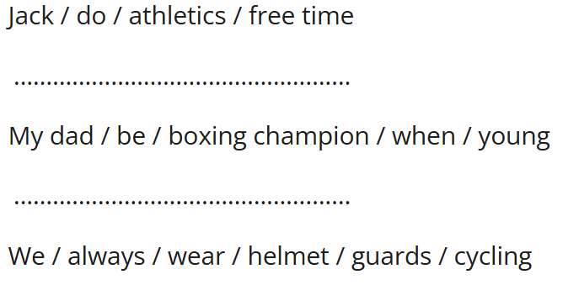
Retrieval Practice
WALT: Make a piece of writing using the first conditional and modal verbs.
Write 3 sentences using the prompts.

Slide 4
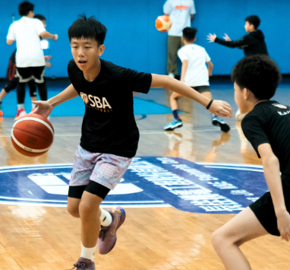
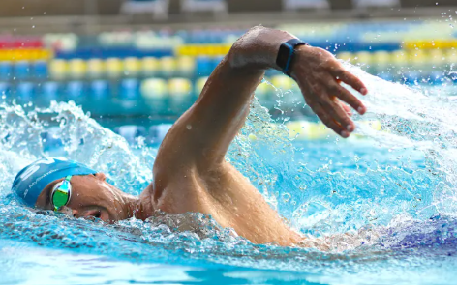
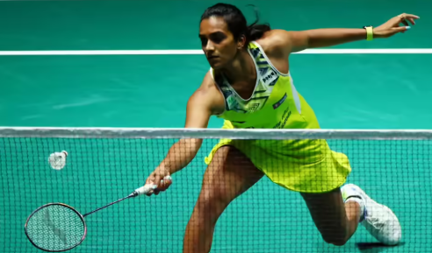
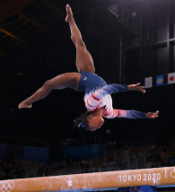
Starter – You’ve got 1 minute to tell your partner all about the sport you will be making a poster about.
WALT: Make a piece of writing using the first conditional and modal verbs.

Slide 5
WALT: Make a piece of writing using the first conditional and modal verbs.
Get your planning document out from last lesson.
Have you written 3 sentences for the first conditional as well as modal sentences?
If you haven’t, you need to do it now!

Slide 6
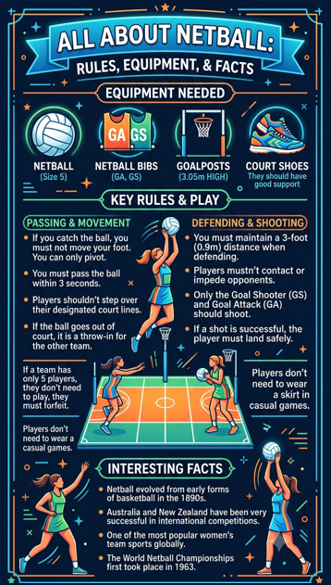
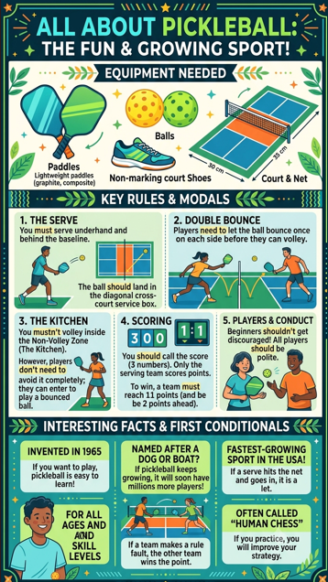
WALT: Make a piece of writing using the first conditional and modal verbs.

Slide 7
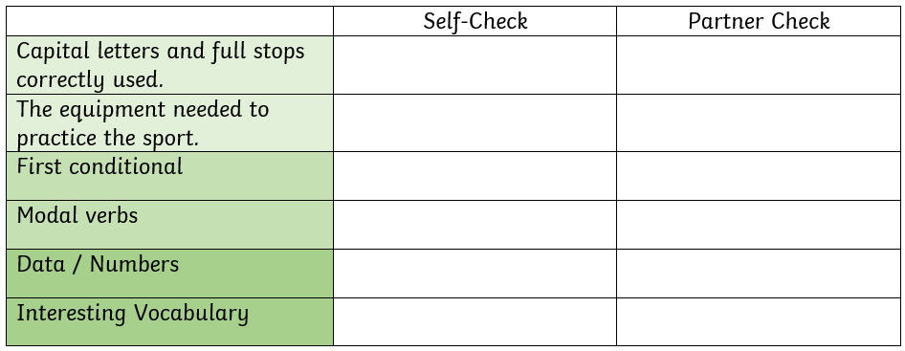
WALT: Write a piece of writing using the first conditional and modal verbs.
These are the success criteria you need to meet in your project.

Slide 8
WALT: Write a piece of writing using the first conditional and modal verbs.
You can make your poster now.
Make sure you include the features from the success criteria.

Slide 9
WALT: Make a piece of writing using the first conditional and modal verbs.
I can create a poster about a sport.
I can include modal sentences in my poster.
I can include the first conditional in my poster.

